Slide 1
Facilitator Guide
Time: 15 minutes
Audience: 1st – 3rd year residents
Objective(s): Discuss and/or demonstrate (depending on capacity of training site) strategies to enhance patient access to their medical home for care

Slide 2
Access Case Study
Adapted from the Center for Excellence in Primary Care

Slide 3
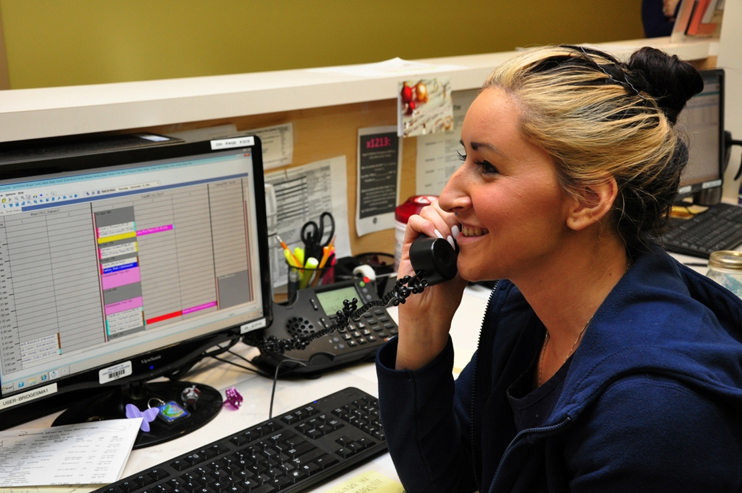
Telephone Access

Slide 4
Lee Tries To Call
Notes:
CHOOSE EITHER ADULT OR PEDIATRIC CASE.
FACILITATOR WOULD READ TO THE GROUP (OR COULD HAVE AUDIENCE MEMBER READ THIS OUT LOUD):
Lee is a 42 year old man who is generally healthy. He sees his nurse practitioner about once a year.
Yesterday, he ran over his foot with a large cart at work, and it remains swollen and painful one day later.
He calls clinic, worried that his foot might be broken. He is on hold for 10 minutes and gives up.
The next day, he calls again. This time, he waits on hold for 20 minutes and gives up again.
He drops into clinic that afternoon, where he is told that he can have an appointment to see his provider tomorrow.
When he arrives at the appointment, he is angry at his provider. He feels betrayed, as though she does not care for him.
“Why is it so hard to get in to see you?” he says at the beginning of the visit, “what’s the point of having a doctor if I can’t see them?”

Slide 5
Lee Tries To Call
Notes:
CHOOSE EITHER ADULT OR PEDIATRIC CASE.
FACILITATOR WOULD READ TO THE GROUP (OR COULD HAVE AUDIENCE MEMBER READ THIS OUT LOUD):
Lee is a 9 year old boy who is generally healthy. He is seen by his nurse practitioner about once a year.
Yesterday, he twisted his foot while playing basketball, and his ankle remains swollen and painful one day later.
Lee’s father calls clinic, worried that his foot might be broken. He is on hold for 10 minutes and gives up.
The next day, he calls again. This time, he waits on hold for 20 minutes and gives up again.
He brings Lee to clinic that afternoon, where he is told that he can have an appointment to see his provider tomorrow.
When he arrives at the appointment, he is angry at Lee’s provider. He feels betrayed, as though she does not care for his him.
“Why is it so hard to get in to see you?” he says at the beginning of the visit, “what’s the point of having a doctor if Lee can’t see her?”

Slide 6
What Happened When You Called?
0
3
5
7
10
minutes
minutes

Slide 7
Ideal State
Resolving all calls during the first contact by the best person to meet each need.

Slide 8
Key Measures for Performance
Measure | How it can be used
Call Abandonment Rate | To monitor the ability of patients to get through to the practice. If the data is available on an hourly basis, it can also help inform staffing levels.
Average Wait Time | To monitor and decrease wait times to improve efficiency and patient experience. Both time in the queue and time spent on hold are affected by staffing and scripting.
Average Talk Time | To monitor and decrease average time spent addressing calls. This measure would be most effective in looking at a centralized call center when improving efficiency in scheduling appointments is most important.

Slide 9
Key Measures for Performance
Measure | How it can be used
% Calls Resolved in 1st Call | To monitor and improve the efficiency of the call system overall. This measure is sensitive to the right staffing (FTE and license) and is a good monitor of waste within the system (ie. Multiple call backs).
Calls per Day | Shows the volume of calls to help plan for staff to meet the demand. Data available on an hourly basis is even more useful.
Reason for Call | Can help identify areas to target improvement efforts. If a particular kind of call is going to staff that can’t help answer the call, an alternative workflow can be developed. If data is available from selections on the phone tree, it is also useful to know where patients are directing their calls.

Slide 10
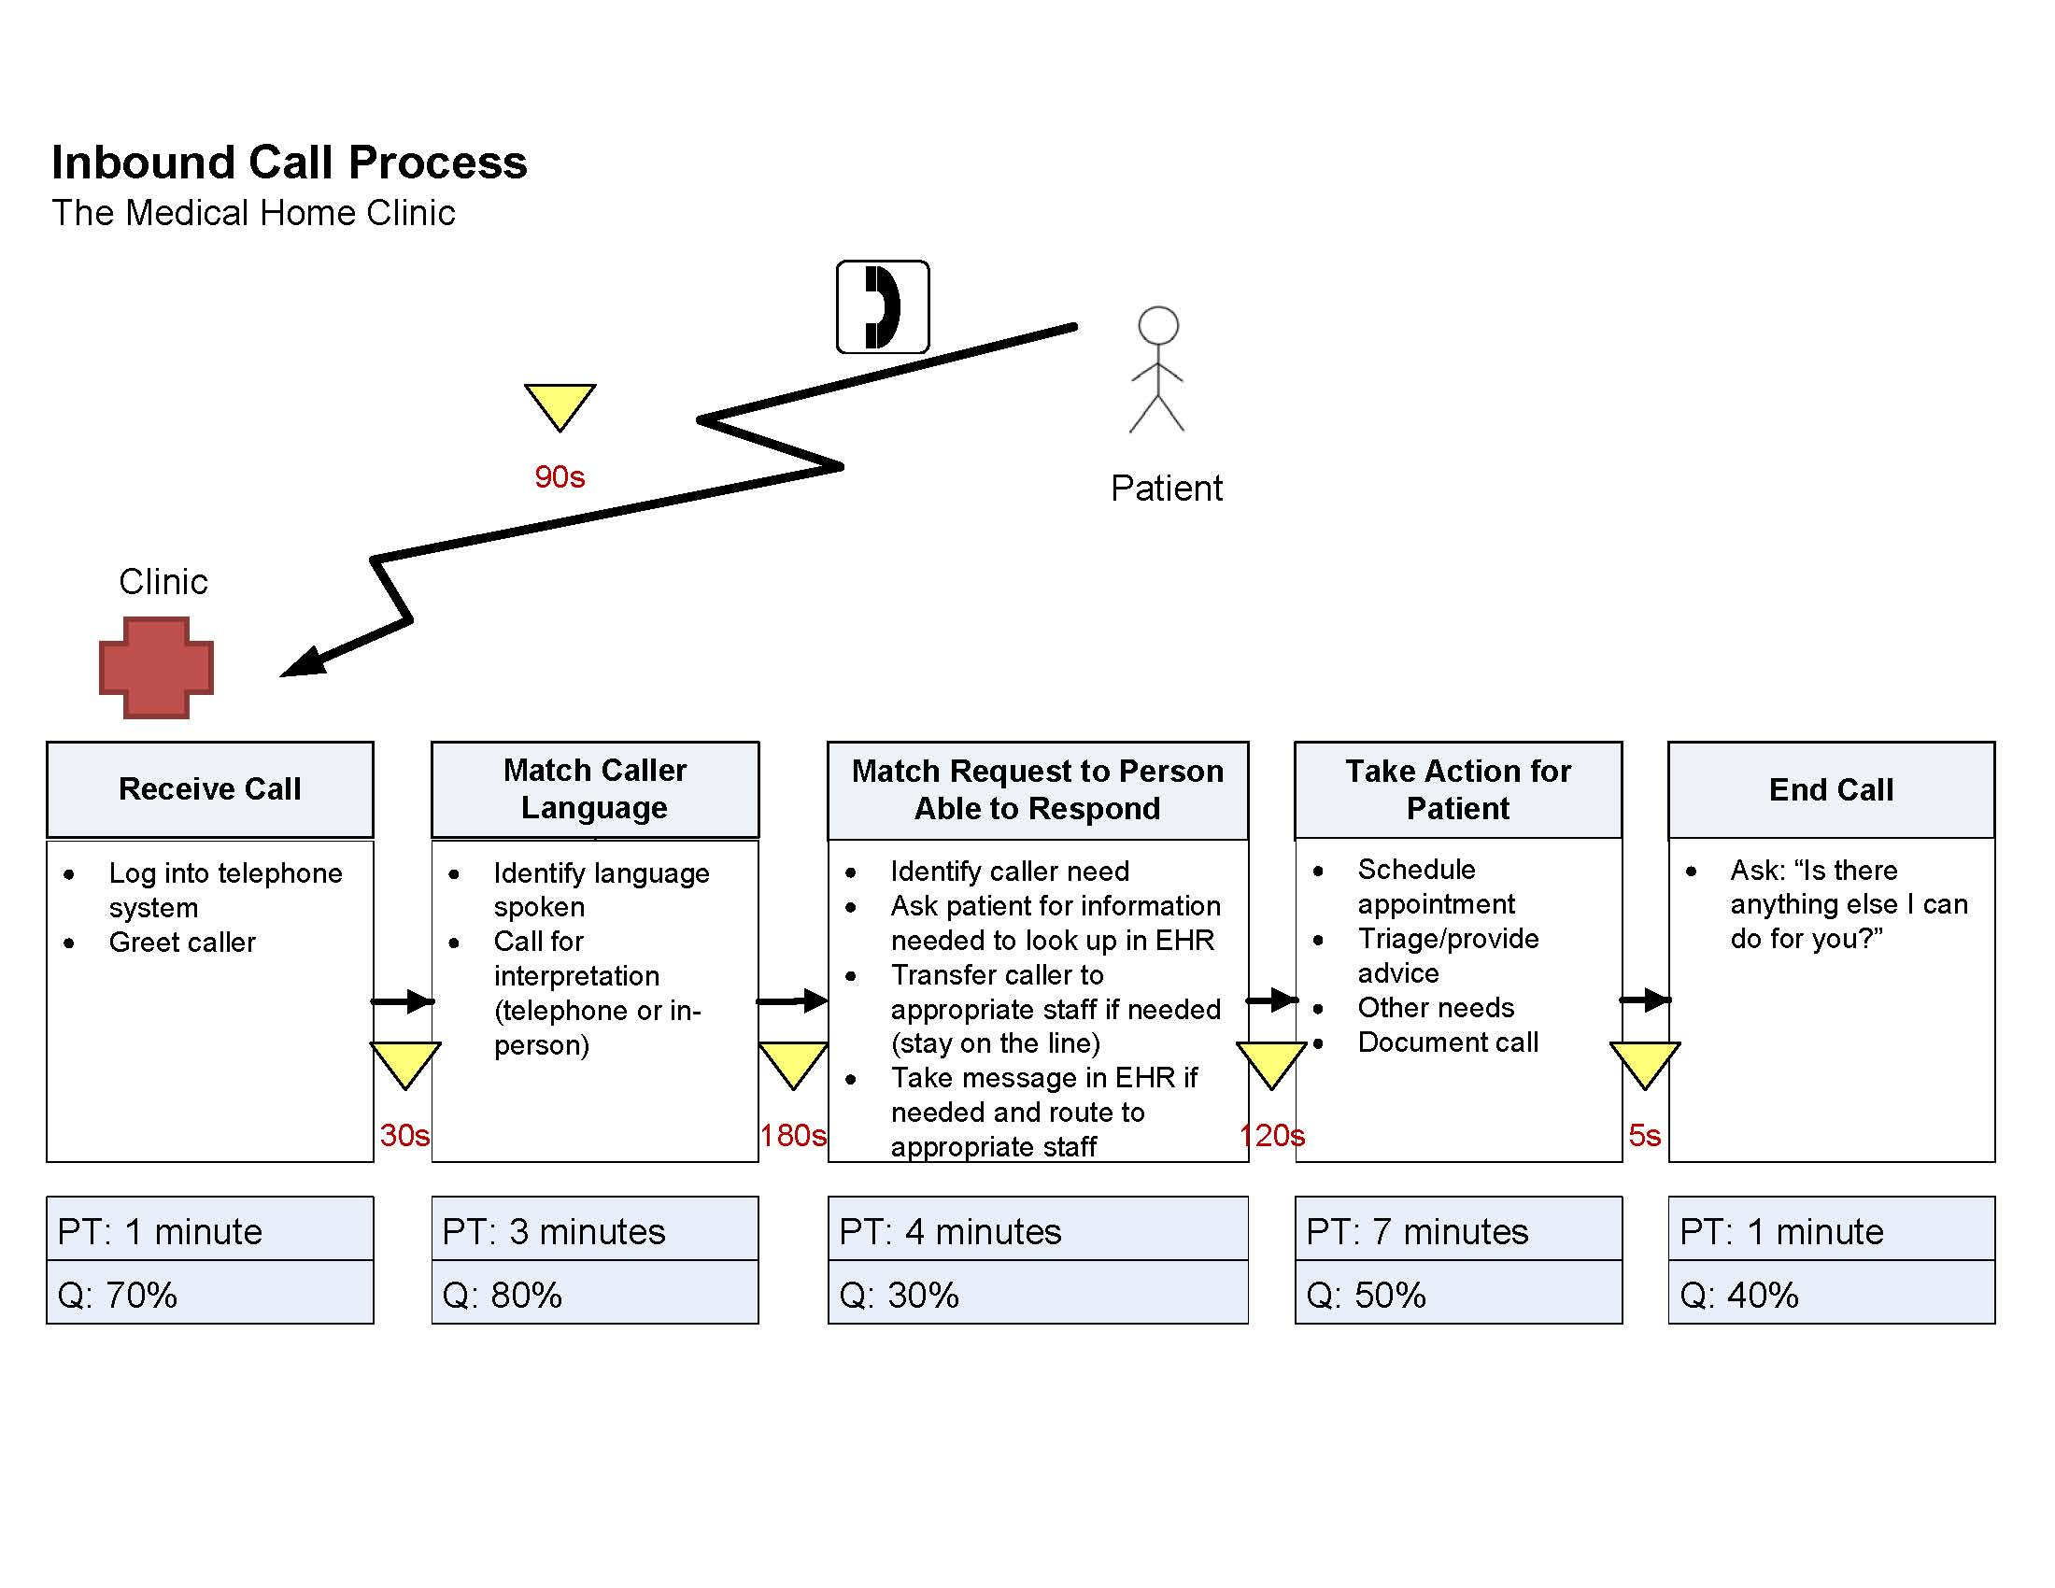
Using a Value Stream Map (VSM)

Slide 11
Tips for Improving Call Process
Limiting phone tree options
Knowing where to send a call
Taking messages effectively
Resolving calls efficiently

Slide 12
Limiting Phone Tree Options
Limit the number of choices offered in a single menu to as few as possible (at most, less than 5)
Tell callers how they can easily reach a “live” person
Give callers an option first, followed by instructions on what key to press (eg “to make an appointment, press 1”)
Let callers know what keys to press to repeat menu options

Slide 13
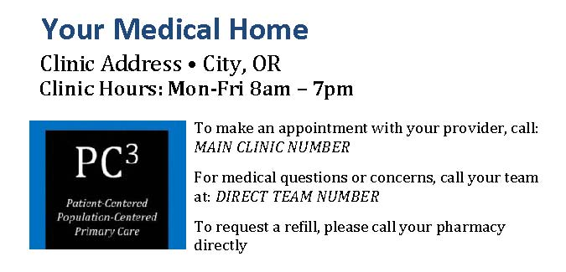
Knowing Where to Send a Call
Non Clinical Calls
Information
Appointment Scheduling
Records Request
Clinical Calls
Advice
Urgent Appointments

Slide 14
Taking Messages Effectively
Scripting!
How much information?
To who?
How?

Slide 15
Resolving Calls Efficiently
Using shared in-baskets/pools
Setting a standard for message turn around time

Slide 16
Lee Gets Through
Notes:
CHOOSE EITHER ADULT OR PEDIATRIC CASE.
FACILITATOR WOULD READ TO THE GROUP (OR COULD HAVE AUDIENCE MEMBER READ THIS OUT LOUD):
Lee calls to make an appointment about his foot.
The phone tree gives him the option to press 1 to make an appointment, which he does. From there, he is told that he can press 1 to leave a message or remain on the line. Because he hates to wait on hold, he presses 1 and leaves a message describing his need.
That afternoon, he receives a call from the clinic from an appointment scheduler. She is able to make him an appointment for the next day.
When Lee arrives at his appointment, he is grateful for the rapid response to his needs and is happy to see his nurse practitioner.

Slide 17
Lee Gets Through
Notes:
CHOOSE EITHER ADULT OR PEDIATRIC CASE.
FACILITATOR WOULD READ TO THE GROUP (OR COULD HAVE AUDIENCE MEMBER READ THIS OUT LOUD):
Lee’s father calls to schedule an appointment about his foot.
The phone tree gives him the option to press 1 to make an appointment, which he does. From there, he is told that he can press 1 to leave a message or remain on the line. Because he hates to wait on hold, he presses 1 and leaves a message describing his son’s need.
That afternoon, he receives a call from the clinic from an appointment scheduler. She is able to make him an appointment for the next day.
When Lee and his father arrive at his appointment, they are grateful for the rapid response to his needs and is happy to see his nurse practitioner.

Slide 18
Questions?

Slide 19
Evaluation
Notes:
See evaluation sheet for thread objective

