Slide 1
Facilitator Guide
Time: 15 minutes
Audience: 1st – 3rd year residents
Objective(s): Discuss and/or demonstrate (depending on capacity of training site) strategies to enhance patient access to their medical home for care

Slide 2
How to Improve Access?
Adapted from the Center for Excellence in Primary Care

Slide 3
Improving Access

Slide 4
Supply and Demand Basics
Supply: Common changes
Provider FTE
# days open
Types/length of appts
Other services (i.e. Behavioral Health, RN Visits)
What else?
Demand: Common Measures
Panel size cap
Standard Return Intervals
Appt Wait Time
Lab Result Availability
What else?

Slide 5
Supply and Demand Management
Keeping panels clean/accurate
Reducing appointment types
Standard templates
Managing capacity

Slide 6
Keeping Panels Clean and Accurate
Tips and Tricks:
For providers who work at multiple sites, run separate panel sizes for each site
This includes outreach sites too!
Develop a policy for how to take patients off of a panel including efforts to contact
Run updated panel sizes monthly so you know how much they change
Run reports based on empanelment status and visit in the last X months

Slide 7
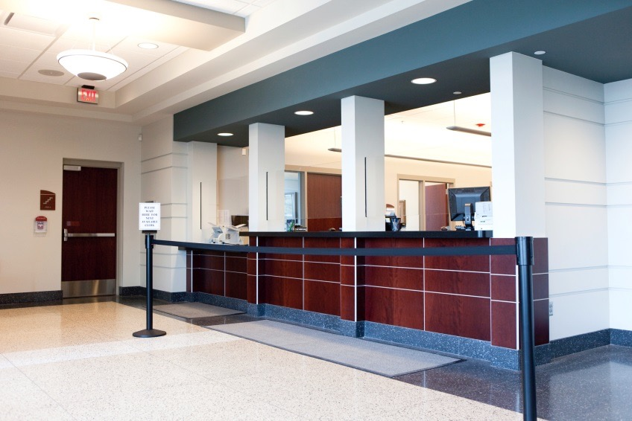
Reducing Appointment Types
Grocery Store
Bank

Slide 8
Reducing Appointment Types
Slots you might still need:
New patient – insured and uninsured
Same day
Future
Special Cases
New providers
Prenatal
Suboxone or anything that only certain providers can do

Slide 9
Standard Templates
Make sure there is enough room on the schedule for huddle, chart review, required breaks, and lunch
Enough appointments to meet productivity goals (include adjustment for no-show rate!)
Easy for schedulers to know where to put patients
Standard appointment times

Slide 10
Managing Capacity
Understand the patient volume patterns over the days of the week by provider, team, and for the clinic as a whole
Map that against current provider FTE/staffing
Smooth out schedule and days off to meet predicted demand

Slide 11
Evaluation
Notes:
See evaluation sheet for thread objective

