Slide 1
Facilitator Guide
Time: 15-20 minutes
Audience:
PGY-1 for introduction to team based care in their clinic and reasoning behind team based care
This powerpoint can be incorporated prior to an interdisciplinary clinic activity to introduce the interns to the team
Objectives:
Team Based Care: Describe and participate in sharing the care for patient panels through expanded team roles by working and communicating effectively with all health care team members.
Procedure: This can be present early in R1 year as a rationale for team based care.

Slide 2
Team Based Care: Intern orientation to team-based care rationale
Adapted from Kaiser Vallejo Family Medicine Residency

Slide 3
Our Resident Clinic Team!
Title of residency and clinic practice
Total number of faculty and non-resident providers
Total number of residents per year
Total number of clinic staff including medical assistants, clerks/receptionists, LVNs, RNs, Pharmacist, Behavioral Health Team, health coaches, MSW
**Add photos of your clinic teams**

Slide 4
Why do Team Based Care?
21.7 hours per day of patient care work for a full-time primary care physician¹
¹Yarnall et al, 2009
Notes:
This is the reason that probably jumps to mind first for any practicing primary care clinician – too much work for one person to handle. Estimate from Yarnall article and referenced in Bodenheimer article “10 building blocks of highly effective primary care” – physician working alone with a panel of 2500 patients would need almost 22 hours a day to provide all recommended preventative and chronic care, and still have time to address acute needs.

Slide 5
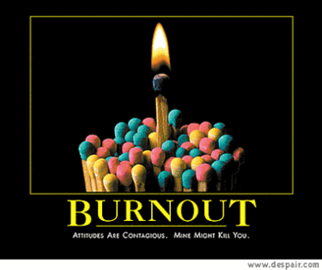
Family Physician Lifestyle Report, 2015:
50% report feeling “burned out”
43% under age 35 are burned out (up from 10% in 2013 survey)
Top reasons cited: too many tasks, too many hours at work
²Medscape Family Physician Lifestyle Report 2015
Notes:
Burn-out – a natural consequence of being faced with 22 hours of work a day by yourself.
Burnout of family medicine physicians is a reality that desperately needs addressing.
Medscape Physician Lifestyle Report received survey responses from almost 20,000 physicians across the country in a variety of specialties – stats reported are specific to family medicine physicians
Evidence from studies on team based care (next slide) suggest that it could help unload tasks, perhaps reduce hours at work, and thus improve burnout statistics

Slide 6
Benefits of team based care for patients
Effective team dynamics can improve patient care coordination between physician colleagues⁶
Team-based care can improve patient perception of confidence in care, care quality and coordination⁷
Team-based care is fundamental in evidence-based models of care delivery that show improved outcomes for patients (ex: Wagner’s Chronic Care Model)⁸
⁶Song et al 2015
⁷Jesmin et al 2009
⁸Bogetz et al 2015
Notes:
Song et al 2015 – cross-sectional, mixed methods (quantitative and qualitative) survey administered to 18 hospital- and community-based, academically affiliated
primary care practices.
Survey included questions to measure team dynamics (effectiveness, communication, culture, accountability, etc), PCP clinical work satisfaction, and PCP perception of patient care coordination with colleagues. (Measures of care coordination included questions regarding whether colleagues understand pt care plan, make appropriate orders/referrals, communicate with main PCP if questions or if plan altered, etc. )
Results showed each increased point on team dynamics score translated to about 10% increase in patient care coordination score reported by PCP
Jesmin study: utilized survey data from almost 11,000 patients in Canada – survey had questions that indicated whether clinical practice had a team, and also patient perception of care and quality indicators. 39% of respondents saw doctors in a team-based care setting.
Results: patients in team-based care practices reported higher perception of the quality of their care over 12 months, higher level of confidence in care provided, higher score on coordination of care (how often does doctor coordinate needed care outside usual office), better accessibility to care
Wagner’s model has several elements, team-based care being a central one, and has shown improvements in quality indicators for patients with chronic diseases.

Slide 7
Benefits of team based care for providers and staff
Effective teams associated with lower burn-out and increased satisfaction scores for physicians and staff^{3,4}
Good team dynamics can increase physician work satisfaction⁵
³Helfrich et al 2014
⁴O’Malley et al, 2015
⁵Song et al, 2015
Notes:
Evidence that team-based care may be able to address the problem of “too much work, not enough time”.
Helfrich: cross-sectional survey of 4500 VA primary c are team members.
Measures: burnout (5-point scale from physician work-life study); team function/clinical delegation, team structure (survey questions)
Results: Lower burnout score associated with fully-staffed teams (good team structure), participatory decision making (team culture). Higher burnout associated with doing tasks someone of lesser training could do (less efficient team function)
O’Malley: survey of PCMH practices that scored highly on measures of team-based care from NCQA; also did qualitative interviews. Qualitative results showed increased physician/MA satisfaction (MAs report feeling more involved in patient care, physicians more satisfied to delegate tasks to MAs/LVNs to focus on more complex patient needs)
Song: quantitative and qualitative surveys to assess team dynamics and PCP satisfaction at 18 primary care sites (including sites with residents)
Results: better team dynamics measures associated with higher scores on physician work satisfaction survey.
Willard Grace: survey of acadamic, VA, and county clinics. All sites had implemented models of team-based care with expanded roles for MA and LVN
Measures: cynicism score from Maslach Burnout Inventory, panel management ability (survey questionnaire designed by research team), team culture measures (survey developed by research team). One question asked specifically about primary care “do-ability” – “primary care is a more do-able job in my clinic this year as compared to last year.
Results: higher panel management scores (ie better delegation of clinical tasks) and higher team culture measures were predictors of lower cynicism and higher “do-ability” of primary care. Higher panel management ability was more predictive of decreased cynicism and better doability of primary care in teams with lower team culture – this may be a helpful strategy to put in place to improve work satisfaction even if team culture does not exist yet.
Overall, results show that team-based care may not only be necessary to provide quality patient care that we know needs to be done, but may have potential to improve retention and pipeline to primary care by mitigating burn-out and increasing satisfaction with the work.

Slide 8
Lee Needs a Team
What type of support does Lee need?
Notes:
CHOOSE EITHER ADULT OR PEDIATRIC CASE
FACILITATOR WOULD READ TO THE GROUP (OR COULD HAVE AUDIENCE MEMBER READ THIS OUT LOUD):
Lee is a 67-year-old woman with uncontrolled diabetes. She is prescribed three oral anti-hyperglycemics but her A1C is still 9.8.
She has not told her physician that she is unable to keep track of her medications and is never sure which ones she has taken or should take. She is not sure which ones are BID or TID, and she has not even picked up her statin from the pharmacy because she is overwhelmed by her pill burden.
She admires and trusts her physician and is embarrassed to share her poor adherence with her.
At today’s visit, her physician tells her that it is time to start insulin. The patient becomes tearful. “No, I’m not ready for that. I’ll just try to take my medicines better, OK? I know I can do it”
Her physician, who doesn’t actually have time to do insulin teaching today, is a little relieved that she has declined it. “Fine,” she says, “we’ll talk about this again at our next visit.”

Slide 9
Lee Needs a Team
Notes:
CHOOSE EITHER ADULT OR PEDIATRIC CASE
FACILITATOR WOULD READ TO THE GROUP (OR COULD HAVE AUDIENCE MEMBER READ THIS OUT LOUD):
Lee is a 3-year-old boy with cerebral palsy, global developmental delay, seizure disorder and dysphagia
His mother, who is the sole caregiver, has not told his physician that she is exhausted; it takes her over one hour to feed him pureed foods; she does not want to rush his feedings because he is at risk for aspiration. She is not sure whether she has been able to provide enough calories because she is overwhelmed by the feeding challenges.
Lee’s mother admires and trusts his physician and is embarrassed to share her poor adherence with her.
At today’s visit, Lee’s physician tells his mother that it is time to consider gastrostomy tube feeding for failure to gain sufficient weight. Lee’s mother becomes tearful. “No, I’m not ready for that. I’ll just try to feed him better, OK? I know I can do it”
Lee’s physician senses that mother is feeling hesitant and overwhelmed, but is running behind and doesn’t have time to discuss how feedings are going at home. Lee’s physician is also a little relieved that she doesn’t have to consult both a gastroenterologist and a surgeon today. “Fine,” she says, “we’ll talk about this again at our next visit.

Slide 10
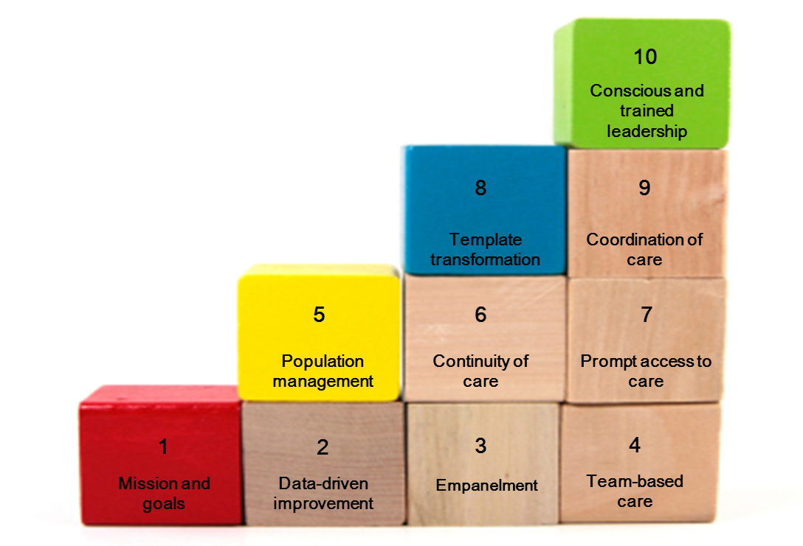
10 Building Blocks of High-Performing Primary Care
⁹Bodenheimer et al, 2014. Center for Excellence in Primary Care, UCSF
Notes:
Evidence that team care is a common factor in highly performing primary care sites seen in Bodenheimer study
In article, Bodenheimer and team surveyed 23 different types of practices that they identified as “high performers” – performing well on one or more of the triple aim measures (quality care, access, cost), high physicain/patient satisfaction, and a variety of payment models. The research team then identified common components (the “building blocks”) employed by these practices, including team-based care. Many of them were in process of transitioning to PCMH or PCMH-like models.
Team based care is considered a “foundational component” – can enhance achievement of other, higher-level blocks.

Slide 11
Why teach about team-based care to medical trainees?
“Despite extensive talk about teamwork within patient-centered medical home initiatives and among policymakers, there is little practical information available to primary care providers on how to function as teams.” ¹⁰
¹⁰Helfrich et al. JGIM. 2014

Slide 12
The Elements of High-Performing Team-Based Care¹¹
A stable team structure
Colocation
Culture shift: Share the care
Defined roles with training and skills check
Standing orders/protocols
Defined workflows and workflow mapping
Staffing ratios adequate to facilitate new roles
Ground rules
Communication: team meetings, huddles, and minute-to-minute interaction
¹¹Ghorob & Bodenheimer. Families, Systems, & Health. 2015

Slide 13
Interpersonal elements in team-based care
Effective teams are characterized by trust, respect and collaboration¹²
Collaboration between health care professionals has shown to improvements in decision making¹³
Improved teamwork and communication are the most important factors in improving clinical effectiveness and job satisfaction¹⁴
¹²Hughes RG, editor. Patient Safety and Quality: An Evidence-Based Handbook for Nurses. Rockville (MD): Agency for Healthcare Research and Quality (US); 2008 Apr
¹³Deming WE. Out of crisis. Cambridge, MA: MIT Center for Advanced Engineering Study; 1982
¹⁴Flin R, Fletcher G, McGeorge P, et al. Anaesthetists’ attitudes to teamwork and safety. Anaesthesia. 2003;58(3):233–42.

Slide 14
Who’s on my team?
Care Team
RN/LVN
Pharm
Health educator
Front Desk/ Clerk
Medical Assistants
Providers
Social Worker

Slide 15
Who’s on my team?
We would recommend including:
An example of what their team will look like
What is the structure of teams in your clinic
What components of a high-performing team are present in your clinic

Slide 16
Lee Has a Team!
Notes:
CHOOSE EITHER ADULT OR PEDIATRIC CASE
FACILITATOR WOULD READ TO THE GROUP (OR COULD HAVE AUDIENCE MEMBER READ THIS OUTLOUD):
When Lee’s physician sees her latest A1C in his inbox, she calls her to discuss it: “I know you’ve been working hard to manage your diabetes,” she says, “and I want to make sure that our team is giving you all the support you need. I’d like to refer you to talk with our diabetes team, if that’s ok with you.”
She agrees to the referral and, at her first visit with the diabetes educator, is pleasantly surprised to be greeted by a gentle, smiling woman who asks her about how diabetes has impacted her life.
“I’m so overwhelmed,” she tells her, “I feel like I just can’t manage all of these pills”.
The diabetes educator helps the patient set small goals and prioritize her treatments, and also refers her to a pharmacist for medication simplification and teaching.
The pharmacist explains each medication to her in detail and arranges pharmacy to deliver the medications in bubble packs sorted by date and time.
At their next visit, the diabetes educator encourages the patient to speak frankly with her provider about her adherence issues, “I know Dr. Smith,” says the educator, “and she doesn’t have a judgmental bone in his body. The more you tell her about how the meds are going, the more he can help you.”

Slide 17
Lee Gets a Team
Notes:
CHOOSE EITHER ADULT OR PEDIATRIC CASE
FACILITATOR WOULD READ TO THE GROUP (OR COULD HAVE AUDIENCE MEMBER READ THIS OUT LOUD):
At Lee’s next visit, his physician plots his latest weight on the growth curve; she then turns to his mother. “I know you’ve been working hard to manage his feedings,” she says, “and I want to make sure that our team is giving you all the support you need. I’d like to refer you to talk with our special care team, if that’s ok with you.”
Lee’s mother agrees to the referral and, at her first visit with the social worker, is pleasantly surprised to be greeted by a gentle, smiling woman who asks her about how Lee’s illness has impacted her life. “I’m so exhausted,” she tells her, “I feel like I just can’t manage all the feedings.”
The social worker helps Lee’s mother apply for IHSS (in-home support services)* and arranges for her to attend a parent support group at the local chapter of Family Voices.†
Lee’s physician has also arranged a consultation with the nutritionist to consider high calorie formula. The nutritionist explains targets for both fluids and calories; and arranges a vendor to deliver the formula supply every month.
At their next visit, the social worker encourages Lee’s mother to speak frankly with his physician about challenges in his daily care; “I know Dr. Smith,” says the social worker, “and she doesn’t have a judgmental bone in her body. The more you tell her about how his care is going, the more she can help you.”

Slide 18
References
Bodenheimer, T., Ghorob, A., Willard-Grace, R., & Grumbach, K. (2014). The 10 Building Blocks of High-Performing Primary Care. The Annals of Family Medicine, 12(2), 166–171. http://www.chcf.org/publications/2012/04/building-blocks-primary-care
Bogetz, J. F., Rassbach, C. E., Bereknyei, S., Mendoza, F. S., Sanders, L. M., & Braddock, C. H. (2015). Training Health Care Professionals for 21st-Century Practice: A Systematic Review of Educational Interventions on Chronic Care. Academic Medicine: Journal of the Association of American Medical Colleges, 90(11), 1561–1572.
Deming WE. Out of crisis. Cambridge, MA: MIT Center for Advanced Engineering Study; 1982.
Flin R, Fletcher G, McGeorge P, et al. Anaesthetists’ attitudes to teamwork and safety. Anaesthesia. 2003;58(3):233–42.
Helfrich, C. D., Dolan, E. D., Simonetti, J., Reid, R. J., Joos, S., Wakefield, B. J., … Nelson, K. (2014). Elements of team-based care in a patient-centered medical home are associated with lower burnout among VA primary care employees. Journal of General Internal Medicine, 29 Suppl 2, S659–666.
Jesmin, S., Thind, A., & Sarma, S. (2012). Does team-based primary health care improve patients’ perception of outcomes? Evidence from the 2007-08 Canadian Survey of Experiences with Primary Health. Health Policy (Amsterdam, Netherlands), 105(1), 71–83.
Hughes RG, editor. Patient Safety and Quality: An Evidence-Based Handbook for Nurses. Rockville (MD): Agency for Healthcare Research and Quality (US); 2008 Apr
Medscape Family Physician Lifestyle Report 2015. http://www.medscape.com/features/slideshow/lifestyle/2015/family-medicine#25
O’Malley, A. S., Gourevitch, R., Draper, K., Bond, A., & Tirodkar, M. A. (2015). Overcoming challenges to teamwork in patient-centered medical homes: a qualitative study. Journal of General Internal Medicine, 30(2), 183–192.
Song, H., Ryan, M., Tendulkar, S., Fisher, J., Martin, J., Peters, A. S., … Singer, S. J. (2015). Team dynamics, clinical work satisfaction, and patient care coordination between primary care providers: A mixed methods study. Health Care Management Review. http://doi.org/10.1097/HMR.0000000000000091. [Epub ahead of print].
Willard-Grace, R., Dubé, K., Hessler, D., O’Brien, B., Earnest, G., Gupta, R., … Grumbach, K. (2015). Panel management, team culture, and worklife experience. Families, Systems & Health: The Journal of Collaborative Family Healthcare, 33(3), 231–241.
Yarnall, K. S. H., Østbye, T., Krause, K. M., Pollak, K. I., Gradison, M. Is there time for management of patients with chronic diseases in primary care? Ann Fam Med. 2005 May-Jun;3(3):209-14.

Slide 19
Evaluation
Notes:
See evaluation sheet for thread objective

