Slide 1
Facilitator Guide
Time: 40-45 min
Audience: 1st – 3rd year residents
Objectives: To apply cultural humility and assess patient’s socio-economic and health literacy needs to facilitate a partnership to provide high quality care.

Slide 2
Cultural Humility and Health Care Disparities
Adapted from Dr. Ellen Chen’s lecture “Using and Equity Lens in Primary Care Quality Improvement” and UCSF’s Cultural Issues in Pediatric Asthma Care.

Slide 3
Objectives
Recognize differences between the clinician and patient view of health and illness may lead to poor adherence
Learn tools to practice cultural curiosity and humility
Review health disparities and health care disparities
Review the complex causes of health care disparities
Describe how QI can be used to identify disparities and help eliminate them

Slide 4
Why Cultural Humility?
Differences between the clinician and patient view of health and illness may lead to poor adherence
Limited information about cultural responses to ill health can contribute to patient-provider miscommunication
Through over-confidence in their own cultures, clinicians can lose sight of their patient’s perspectives, beliefs, and wisdom
Cultural humility reminds providers to be curious about and actively engage their patient’s cultural perspectives
“Culture and language can profoundly affect Latino children’s health, but not enough cultural competency training of health care professionals and provision of linguistically appropriate care occur.” –Cross, et al
Cross, T., Bazron, B., Dennis, K., & Isaacs, M. (1989). Towards a culturally competent system of care, volume I. Washington, D.C.: Georgetown University Child Development Center, CASSP Technical Assistance Center. Flores G. et al. The Health of Latino Children: Urgent priorities, unanswered questions, and a research agenda (2002 ) JAMA

Slide 5
Case: Cultural Disconnect
Notes:
CHOOSE EITHER ADULT OR PEDIATRIC CASE
FACILITATOR WOULD READ TO THE GROUP (OR COULD HAVE AUDIENCE MEMBER READ THIS OUT LOUD):
Lee is a 65 year old woman. Her parents immigrated to the US before she was born. This is her first visit in clinic.
She has asthma as a child and has noticed a recurrence of occasional shortness of breath. She believes that this is due to the recent rapid change in temperature, which can weaken lungs. She is hoping that her provider can address this.
Her provider takes a brief history, listens to her lungs, and notes no wheezing. Given her age, the provider is more concerned about angina than asthma and refers her for a cardiac study.
Ms. Lee is disappointed by her physician’s incompetence and chooses not to follow up on the study.

Slide 6
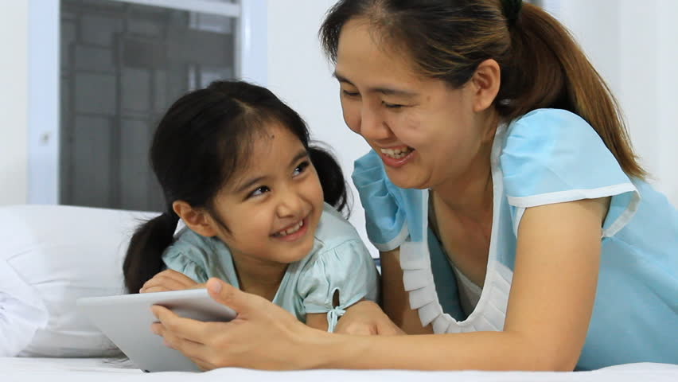
Case: Cultural Disconnect
Notes:
CHOOSE EITHER ADULT OR PEDIATRIC CASE
FACILITATOR WOULD READ TO THE GROUP (OR COULD HAVE AUDIENCE MEMBER READ THIS OUT LOUD):
Lee is a 2 year old girl. Her parents immigrated to the US before she was born. This is her first visit in clinic.
She has been diagnosed with asthma since an infant and her parents have noticed increasing shortness of breath. They believe that this is due to the recent rapid change in temperature, which can weaken lungs. They are hoping that her clinician can address this.
Lee’s clinician takes a brief history, listens to her heart and lungs, and notices a heart murmur but no wheezing. Given history of poor weight gain, the clinician is more concerned about congenital heart disease than asthma and refers her to a cardiologist.
Lee’s parents are disappointed by her physician’s incompetence. They respect the physician role so are polite and say they will do what is recommended, but later they choose not to schedule an appointment with the cardiologist.

Slide 7
Why Cultural Humility?
Nearly half of the children in California are Hispanic and/or have a foreign-born parent.
Currently one of three of families speak a language other than English
It is projected that by 2020, 76% of our children will be from “ethnic or racial minority” groups
One out of every 8 children in the United States lives in California
Cross, T., Bazron, B., Dennis, K., & Isaacs, M. (1989). Towards a culturally competent system of care, volume I. Washington, D.C.: Georgetown University Child Development Center, CASSP Technical Assistance Center.

Slide 8
Practicing Cultural Humility and Curiosity: Tools and Strategies for Everyday Practice

Slide 9
Practicing Cultural Humility: Addressing Differences in Perceptions about Illness
Patients have explanatory models of illness that are influenced by culture
Can be challenging when the provider is not familiar with patient’s background
Differing perceptions about illness affect treatment by…
Preventing the sharing of information during visit (e.g., history of symptoms, etc.)
Posing challenges to the development of a feasible plan
Motivating the patient around the importance of adherence to a plan
Carillo JE, et al. Cross-cultural primary care: a patient-based approach (1999). Ann Intern Med. 130: 829-834

Slide 10
Practicing Cultural Humility: Addressing Challenges Tool: Awareness-Assessment-Negotiation Technique
Become Aware of the commonly held ethnomedical beliefs of the groups in your community
Assess the likelihood that a particular patient may act on these beliefs during a particular illness episode
Negotiate between the biomedical and ethnomedical belief systems

Slide 11
Practicing Cultural Curiosity: Tool
Asthma History: example questions
What do you think is wrong?
Why do you think you have this illness?
What do you think caused it?
Why do you think it started when it did?
What do you think happens inside your body when you have an asthma attack?
What are the symptoms that make you know that you’re going to have an asthma problem?
What are you most worried about with asthma?
What problems does it cause you?
How long do you expect it to last?
How do you treat it?
What will happen if it is not treated?
What do you expect from the therapies?
Practicing Cultural Competency: Tools Modified from Kleinman A. Patient and healers in the context of culture. 1980. U of C Press. Berkeley.

Slide 12
Practicing Cultural Humility: Tool Alternative Therapy History
Preface conversation with a normalizing statement
e.g.“It is common for families to treat asthma with effective remedies not prescribed by a physician…”
Then engage the patient with nonjudgmental questions
Have you heard of any of these treatments for asthma? What are they?
Do you think they would work?
Have you tried them?
Did they work?
Are you using them now?
Are they helping your asthma?
Modified from Pachter LM, et al. Variation in asthma beliefs and practices among mainland Puerto Ricans, Mexican-Americans, Mexicans and Guatemalans. J Asthma. 2002; 39:119-134.

Slide 13
Practicing Cultural Humility: Tool Non-Verbal Communication Skills
Learn about your patient’s cultural norms regarding personal distance, gestures, eye contact and posturing
Watch your patients for clues about cultural norms. If you are not sure about their cultural norms, ask them. Example questions include:
How do you and your family prefer that we discuss difficult news, if it ever comes up?
Some patients prefer to work with the physician to make a plan together. Others prefer that I just tell them what I think the best plan is. What is your preference?
When using an interpreter, speak directly to the patient and don’t interpret lack of eye contact as a lack of interest
Be aware that use of an interpreter can change the dynamics of the provider patient relationship and affect the sharing of sensitive personal info

Slide 14
Case: Cultural Humility in Action
Notes:
CHOOSE EITHER ADULT OR PEDIATRIC CASE
FACILITATOR WOULD READ TO THE GROUP (OR COULD HAVE AUDIENCE MEMBER READ THIS OUT LOUD):
When Lee describes her symptoms, her provider, who is Caucasian and is aware that there may be cultural differences in their health beliefs, asks “Do you have a theory about what is causing this shortness of breath?”
Lee explains her theory. The provider, unfamiliar with a belief system in which a change in weather weakens lungs, asks more questions: “In your culture, what is the best way to strengthen lungs that have been weakened?”
Lee explains that she needs to drink hot tea, wear scarves, take warming herbs and eat warming foods.
The doctor agrees that these are reasonable things to try. He also expresses his concern that this might be cardiac. “I’d like to also look for some things that my own medical culture says might be causing this. Would you be willing to go to another appointment to check your heart?”
Lee, pleased by her physician’s respect for her beliefs, is happy to also respect his concerns and agrees to attend the appointment.

Slide 15
Case: Cultural Humility in Action
Notes:
CHOOSE EITHER ADULT OR PEDIATRIC CASE
FACILITATOR WOULD READ TO THE GROUP (OR COULD HAVE AUDIENCE MEMBER READ THIS OUT LOUD):
When Lee’s parents describe her symptoms, her clinician, who is Caucasian and is aware that there may be cultural differences in their health beliefs, asks
“What do you think is causing Lee’s shortness of breath?”
Lee’s parents explains their theory. The clinician, unfamiliar with a belief system in which a change in weather weakens lungs, asks more questions: “In your culture, what is the best way to strengthen lungs that have been weakened?”
The parents explains that she needs to drink hot tea, wear scarves, take warming herbs and eat warming foods.
The clinician agrees that these are reasonable things to try. He also expresses his concern that this might be cardiac. “I’d like to also look for some things that my own medical culture says might be causing this. Would you be willing to go to an appointment to check Lee’s heart?”
Lee’s parents, pleased by her physician’s respect for her beliefs, is happy to also respect his concerns and agrees to schedule the appointment.

Slide 16
Health Care Disparities

Slide 17
Definitions: Health Disparities vs Health Care Disparities
Health Disparities
Systemic differences in health between groups that differ in social privilege
Contributing factors include physical and social environment, lifestyle, stress, genetics and healthcare.
Health Care Disparities
Systemic differences in healthcare between groups that differ in social privilege. HCD account for a small proportion of Health Disparities.

Slide 18
Health Disparities Example: Cause of death in SF: Ischemic Heart Disease 2009-2012 Health Matters in SF
Age-adjusted Mortality Rates from IHD By Race/Ethnicity and Sex, SF
African Am M 150.2 F 113.8
White M 107.1 F 69.4
Latino M 88.7 F 44.4
Asian M 67.8 F 40.4
Per 100,000 population
Based on ICD9 codes for leading cause of death
SF Department of Public Health

Slide 19
Health Disparities Example: Cause of death in SF: Cerebrovascular disease 2009-2012 Health Matters in SF
Age-adjusted Mortality Rates from Stroke By Race/Ethnicity and Sex, SF
African Am M 59.9 F 53.7
Asian M 41.1 F 33.6
Latino M 31.3 F 28.1
White M 25.8 F 28.0
Per 100,000 population
Based on ICD9 codes for leading cause of death
SF Department of Public Health

Slide 20
Brainstorm! What are potential causes of this disparity in stroke mortality rates?
Safe exercise options
Healthy food choices
Target tobacco ads vs. target public health education
Lifestyle choices
Stress
Employment
Housing
Genetics
SES/ literacy
Primary care access and use
Primary care quality for hyperlipidemia, HTN, DM, tobacco counseling
Medication education/access
Language access
Health literacy
Diagnosis and treatment of TIA/ CVA
Access to acute interventions
Referral to carotid endarterectomy

Slide 21
HCD: What is known so far?
There are differences in the process of health care for racial and ethnic minorities.
Multiple studies have documented differences in care: A study of 17,400 Medicare patients presenting with TIA showed
African Americans were 83% as likely as whites to receive noninvasive cerebrovasular imaging.
Those who did were 54% as likely to receive noninvasive cerebral angiography.
Among this last group, the odds ratio of African Americans receiving carotid endarterectomy was 0.27.
The study adjusted for comorbid illness, ability to pay, and other demographic variables.
Mitchell 2000

Slide 22
Unequal Treatment Confronting Racial and Ethnic Disparities in Healthcare
In 2002, the Institute of Medicine released this report, reviewing the evidence that racial and ethnic minorities receive lower quality of care, even when socioeconomic and access-related factors are controlled.
Race and ethnicity are predictors of the quality of healthcare received.
http://www.iom.edu/Reports/2002/Unequal-Treatment-Confronting-Racial-and-Ethnic-Disparities-in-Health-Care.aspx
Institute of Medicine 2002

Slide 23
Health Care Disparities Model
Access to Care
Clinical Appropriateness
and Need
Non-Minority
Dissimilarity
Patient Preferences
Difference
Minority
Operation of healthcare systems and legal and regulatory climate
Disparity
Provider Bias, Decision Making and Communication
Quality of Care
Source: Gomes, C. and McGuire T.G. 2001. Identifying the sources of racial and ethnic disparities in health care use. Unpublished manuscript cited in: IOM,. 2002. Unequal Treatment: Confronting Racial and Ethnic Disparities in Health Care. Smedley, B., A. Stith and A. Nelson, eds. Washington DC: National Academy Press

Slide 24
Healthcare systems and legal regulatory climate
Macrosystems
No universal health insurance
Low Medicaid reimbursement
Pay for performance induces providers to choose healthier patients, avoid complex social situations
Microsystems within Delivery systems
Appointment systems may be easier to navigate for some, assume free time during the day
Team delivery of care can decrease barriers
Interpreter services decrease barriers
Health coaches decrease barriers

Slide 25
Essential Characteristics of Quality Health Care
Effective
Patient-centered
Timely
Safe
Equitable
Efficient
Institute of Medicine 2001

Slide 26
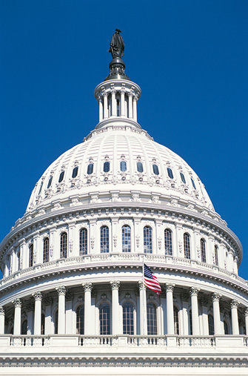
Framing HCD as a Quality of care problem
Health and Human Services Secretary required to submit annual report to Congress:
National trends in health care quality (National Healthcare Quality Report, or NHQR)
Prevailing disparities in health care delivery as it relates to racial factors and socioeconomic factors in priority populations (NHDR
Mandated by Congress in Healthcare Research and Quality Act (PL. 106-129)
Agency for Healthcare Research and Quality.
http://www.ahrq.gov/research/findings/nhqrdr/nhdr11/index.html#

Slide 27
ACCESS: After years without improvement, the rate of uninsurance among adults ages 18- 64 decreased substantially during the first half of 2014
Adults ages 18-64 who were uninsured at the time of interview, 2000-2014
National Center for Health Statistics, National Health Interview Survey, 2000-June 2014.

Slide 28
Equity as a Quality issue: Interventions
Do QI efforts reduce or increase HCD?
Broad range of interventions
Mixed results
Expert consensus that general QI may help but probably not sufficient to reduce HCD
Instead, tailored interventions to particular racial/ethnic groups

Slide 29
HCD as a Quality of care problem: Interventions
Target all patient but use culturally appropriate approaches
RCT for depression [Miranda 2003]
Target specific groups who have been receiving lower-quality care
Aetna’s diabetes management pilot program for African Ams and Latinos

Slide 30
Best Practices
Finding Answers: Disparities Research for Change http://www.solvingdisparities.org/tools/roadmap
Multifaceted approaches
Focus on cultural relevancy
Nursing staff led programs
Interactive education
Family and community programs

Slide 31
Supporting Accreditation Organizations and Policy
Joint Commission
Centers for Medicare and Medicaid
NCQA
Affordable Care Act 2010
American Recovery and Reinvestment Act 2009
Medicare Improvements for Patients and Providers Act 2008

Slide 32
National Committee for Quality Assurance standards
Data Collection Methods and Policies
Access, Availability and Evaluation of Language Services
Network Diversity and Cultural Competence
Commitment to Accountability and Quality Improvement

Slide 33
The FOCUS-PDCA Cycle
Find a process improvement opportunity
Organize a team of individuals who understand the process
Clarify current knowledge about the problem
Uncover/understand the causes of variation
Select a process improvement/Start the PDCA cycle

Slide 34
FOCUS-PDCA (cont.)
Plan the process improvement
Do the process improvement, data collection, and data analysis
Check/study the results
Act by abandoning, adjusting or adapting the change; hold on to gains

Slide 35
Hypertension Control
About 1/3 of US adults, 67 million, have high blood pressure
Only 47% of these adults have their BP under control
89% of this population reported a usual source of care
Vital Signs: Awareness and Treatment of Uncontrolled Hypertension Among Adults — United States, 2003–2010.CDC.

Slide 36
Primary Care Providers Perceptions of Racial/Ethnic and Socioeconomic Disparities in Hypertension Control
Conclusion: Most providers acknowledged that racial/ethnic and socioeconomic disparities in hypertension control exist in the US health system, but only a minority reported disparities in care among patients they personally treat. Our study highlights the need for testing an intervention aimed at increasing provider awareness of disparities within the local health setting to improve hypertension control for minority patients.

Slide 37
Summary
Address differences in perception about illness
Practice cultural competency and cultural humility
HCD are issues of Quality of care.
Focus on systems of care as well as physician behaviors is necessary.
We can use QI to address HCD in the microsystems in which we work.

Slide 38
Evaluation
Notes:
See evaluation sheet for thread objective

