Slide 1
Facilitator Guide
Time: 30 minutes for presentation, 15 minutes for discussion
Audience: mid-late PGY-1 and/or PGY-2 and PGY-3
Objectives: Describe the larger medical network they are a part of and recognize gaps and opportunities in care integration.
Procedure:
Refer to “CT_4_Larger Medical Network Example, R1-R3s, 45mins” as a sample of a lecture on a medical network
Can use in conjunction with the Medical Neighborhood Care Integration Assessment Activity

Slide 2
Overview of {name} health network: An overview of a health network with a focus on the primary care practices and care integration
Adapted from “SFHN Update” and “Practice Coaching for Primary Care Practice Transformation Training” by the Center for Excellence in Primary Care

Slide 3
Overview
{name} health network
Scope
Statistics
Payors
Primary Care Program
Programs
Leadership
Vision and Priorities
Health care integration
Discussion:
Gaps and opportunities in care integration
Optional: use “CT_4_Medical Neighborhood Care Integration Assessment Group Activity” jointly with this powerpoint for a robust discussion on care integration

Slide 4
{name} health network
Describe the larger network and how it fits into a City/County’s care system
State the slogan (if any) of your health network
For example,
San Francisco Health Network is the umbrella organization that includes all of San Francisco’s safety net organizations
The slogan is “Your Bridge to Wellness”

Slide 5
Organizational chart of {name} health network
Put in an organizational chart for your audience to understand how it fits in and who leads ambulatory care/primary care

Slide 6
{name} health network scope of services
Provide information including:
How many patients are served by the network?
Is hospital, specialty care, diagnostic, and/or emergency care provided?
Are behavioral health services included?
Skilled nursing facility?
Substance use services?
Maternal and pediatric care?
Any other services (i.e. jail, homeless)

Slide 7
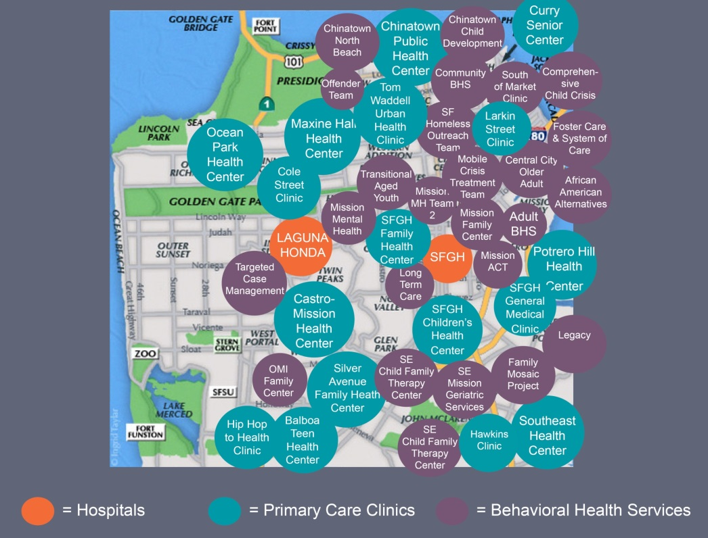
{name} health network map
Based on the services described in the prior slide, consider putting a visual image of all the services provided (i.e. hospital, primary care clinics, and/or behavioral health services – see example below)

Slide 8
{name} health network statistics
Select some visual data including types of services, patients seen, demographics, age, race (as per below)

Slide 9
{name} of health network payors
Describe the different payors to the health network
For example, Medicare and/or Medicaid or private insurances
Can consider putting in visuals to describe patients managed by a health plan/insurance

Slide 10
{name} of health network access
Describe in visual form access to the various services your network providers
TNAA – third next available appointment is recommended as a universal way of describing access

Slide 11
{name} health network – Primary Care
Recommended outline of key overview components of primary/ambulatory care program:
Mission/vision
Clinical practices
Leadership team
Strategic network priorities

Slide 12
{name} health network – Primary Care Services
Highlight the various primary/ambulatory care services/programs (i.e. behavioral health, dental, etc).
Consider going more in-depth on how the network selected the priorities and showing data on how the network is doing
For example, if the network is working on improving third- next available routine appointment (TNAA) show a dashboard of the data driven improvement (refer to example in the CT_4_ Larger Medical Network Example powerpoint, slides 29-52)

Slide 13
{name} health network – Care coordination and integration
Discuss care integration of primary care services within your organization
You can begin by using the following slides (14-20) that give an overview of care coordination and integration

Slide 14
Lee needs dental care
What can Lee’s doctor do to help integrate dental care in her clinic?
Notes:
FACILITATOR WOULD READ TO THE GROUP (OR COULD HAVE AUDIENCE MEMBER READ THIS OUT LOUD):
Lee is a 2-year-old boy (for adult case just change to adult case and photo of adult patient) coming in to see his primary care doctor for his routine physical exam and vaccinations. His doctor identifies risk factors for caries and is concerned about caries given some white spots he sees on Lee’s teeth.
Lee’s doctor makes a referral to a dentist, but the wait is long and he wonders if there’s something he can do today.

Slide 15
What is care integration?
Barbara Starfiled’s 4 pillars of Primary Care²
Patient care that is coordinated across professionals, facilities, and support systems;¹
Continuous over time and between visits;
Tailored to the patients’ needs and preferences;
And based on shared responsibility between patient and caregivers for optimizing health”
Primary Care
Comprehensive Care
Coordination of Care
First Contact Care
Continuity of Care
¹Singer, et al. SJ. Defining and measuring integrated patient care: promoting the next frontier in health care delivery. Medical Care Research and Review. 2011;68(1):113-127
²Starfield B. Primary Care: Balancing Health Needs, Services, and Technology. New York: Oxford University Press, 1998.

Slide 16
Two facets of care integration
COMPREHENSIVENESS: Bridging services into primary care
COORDINATION: Building relationships with services outside of primary care

Slide 17
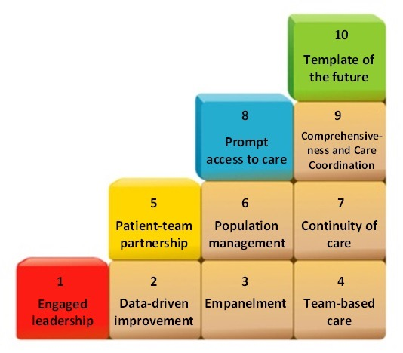
How does care integration fit?

Slide 18
The need
The typical primary care clinician interacts with 229 other providers in 117 different practices.
The probability that a clinician visit will result in a referral to another clinician almost doubled from 1999 to 2009.
42% of adults with health problems report problems with the coordination of their care.
Exchanging data with outside practices or laboratories are two of the least often met criteria for meaningful use.
Audet AM, et al. The Care Coordination Imperative: Responding to the Needs of People with Chronic Diseases. The Commonwealth Fund Blog. 21 February 2012. http://www.commonwealthfund.org/Blog/2012/Feb/Care-Coordination-Imperative.aspx
Schoen C, et al. New 2011 survey of patients with complex care needs in eleven countries finds that care is often poorly coordinated. Health Aff. 2011;30:2437-2448.
IMS Institute for Healthcare Informatics. Avoidable Costs in U.S. Healthcare: The $200 Billion Opportunity from Using Medications More Responsibly. June 2013. DesRoches CM, Audet AMJ, Painter M, Donelan K. Meeting meaningful use criteria and managing patient populations: A national survey of practicing physicians. Annals of Internal Medicine. 2013;158(11):791-799.

Slide 19
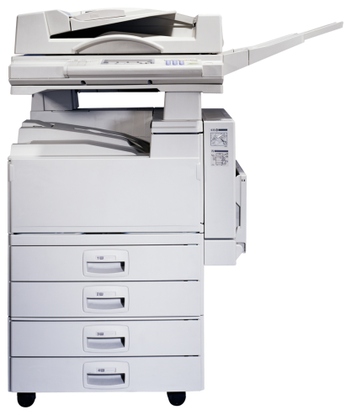
Care Coordination = The Solution!

Slide 20
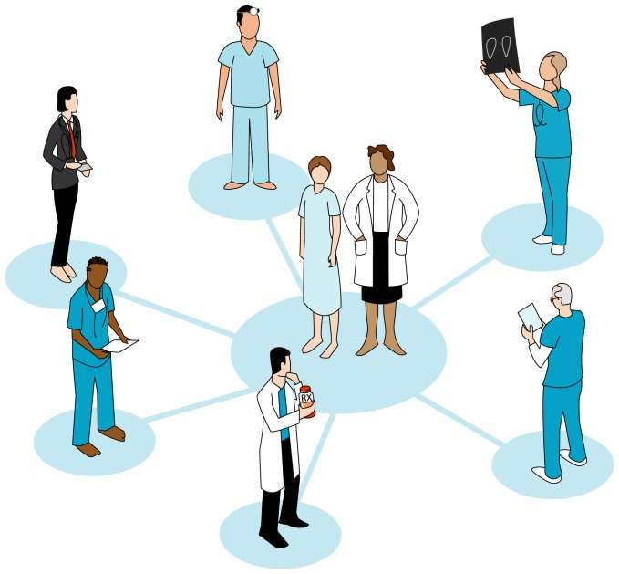
The Medical Neighborhood Care Integration Assessment (MNCI-A©)
Center for Excellence in Primary Care
Kate Dubé
Rachel Willard-Grace, MPH
Ashley Rubin, MS
Tom Bodenheimer, MD
Kevin Grumbach, MD
J. Nwando Olayiwola, MD, MPH
http://www.careinnovations.org/knowledge-center/facilitating-care-integration/assess-your-practice/

Slide 21
The Medical Neighborhood Care Integration Assessment
The “Medical Neighborhood Care Integration Assessment” is a tool that can be completed in its entirety or through domain-specific modules
For each domain the tool is divided into success of integration (1-10 scale) and specific strategies used (1-5 scale).
Ideally, the assessment is completed with a representative sample of the clinic including patient advocates, on a regular basis, to enable practices to track improvement over time.

Slide 22
The Medical Neighborhood Care Integration Assessment
Options based on time:
If time allots, you can incorporate the “CT_4_Medical Neighborhood Care Integration Assessment Activity” into this section
If you have a limited amount of time you can open up the time for a 5-10 minute discussion of gaps and opportunities in care integration based on your network information that was presented

Slide 23
Lee gets preventative dental care!
Notes:
FACILITATOR WOULD READ TO THE GROUP (OR COULD HAVE AUDIENCE MEMBER READ THIS OUT LOUD):
Lee’s doctor and his colleagues in his clinic complete the section “Primary Care – Oral Health Integration” of the Medical Neighborhood Care Integration Assessment. They find that a strategy they could work on as a clinic is to learn to administer fluoride varnish and integrate it into routine well child visits in their practice.
After all of the staff and providers learn to visual inspect children’s teeth, the medical team starts administering fluoride varnish. By doing so they are helping significantly with prevention and reduction of caries. From now on Lee will not only get a dental referral but also fluoride varnish in clinic!

Slide 24
Evaluation
Notes:
See evaluation sheet for thread objective

