Slide 1
Facilitator Guide
Time: 45 min for lecture, 45-60 min for group activity
Audience: 2nd year or 3rd year residents
Objectives: Introduction to concept of population management and vocabulary, tools for doing population management, practice with own patients

Slide 2
Tools for Population Management: Close the Care Gaps!

Slide 3
Goals and Objectives
Define population management
Understand why empanelment is the foundation of population management
Articulate key principles of population management
Choosing target populations
Choosing interventions and outcome measures
Using In-reach and out-reach to address care gaps
Recording data to review trends over time
Practice population management with our own patients

Slide 4
Case: Lee Needs Panel Management
Notes:
Case summary:
--Lee is a 60 year old man who has never had colon cancer screening.
--He rarely comes into clinic and only presents for urgent needs. His last visit was two years ago.
--Because he only presents for urgent visits, he has never been offered colon cancer screening

Slide 5
Photo source: BK (Flickr). https://www.flickr.com/photos/pictoquotes/15591790395. Original photo source: Felix Ulich (https://pixabay.com/en/rain-gutter-gutter-roof-cobweb-473845/)
Notes:
Why should we do population management? Repair the roof before the storm comes in!
--prevention of chronic disease is the foundation of a long, healthy life. Prevention helps to prevent more complicated disease later on
--tracking high-risk populations that already have chronic disease ensures that all are getting care to help them live longer and healthier
--take a proactive as opposed to a reactive approach to medicine
--national trends: pay-for-performance incentives and quality reporting to NCQA – family physicians will need to know how to do this

Slide 6
Population Management…
“… a ‘systems approach’ to primary care. A systems approach involves collecting data to … identify and monitor those who need care; finding and implementing the latest care guidelines; and involving [others] -your office staff, nurses, other physicians and other caregivers in evaluating and improving your performance.”
Source: Rivo, M. It’s Time to Start Practicing Population-Based Health Care - Family Practice Management. (n.d.). Retrieved April 1, 2016, from http://www.aafp.org/fpm/1998/0600/p37.html
Notes:
What is population management? Brainstorm ideas before sharing text on slide
A “systems” approach
--can touch many more patients that need care with a systems-based strategy, rather than waiting for them to arrive individually and seeing them one-by-one
--utilizes other team members to extend your reach as a physician
--allows us to evaluate our own performance over time – how are we doing in applying the care that we know makes the most difference, to the patients that need it most?

Slide 7
Population Management Starts with a PCP or Care Team
Notes:
Why is it important for a patient to have an assigned PCP in order to do good population management? Think-pair-share activity (2 minutes to think/talk, 2 minutes to share)

Slide 8
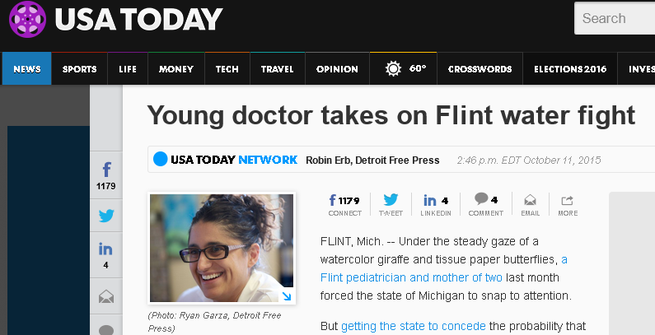
Population Management Starts with a PCP
Relationship = Trust = Better adherence to recommendations
Accountability
Owns/updates the registries (or supervises others)
Remains attentive to health trends
Notes:
Why is this?
--data exits that an ongoing relationship with a PCP that allows building trust results in better med adherence, greater honesty in reporting risky health behaviors, better clinical outcomes
--Accountability – who will track the needs of each patient in these population over time, remain aware of changing needs, ensure health outcomes improving, and generate interventions if not improving? This can be single PCP or a care team
--Attention to health trends – same doctor seeing same group of patients will notice changes in sub-populations over time or the emergence of new populations that need tracking (ex: Flint Michigan – appearance of unusual number of children with lead poisoning.)

Slide 9
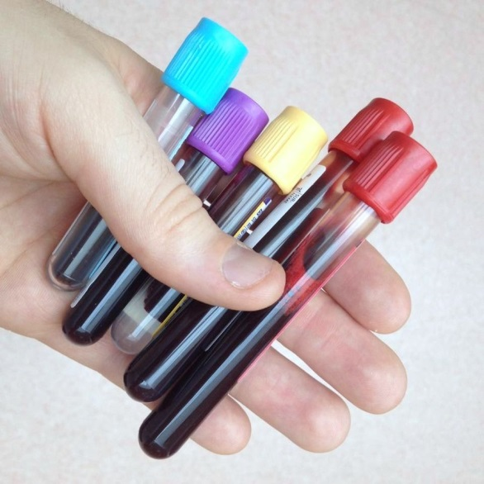
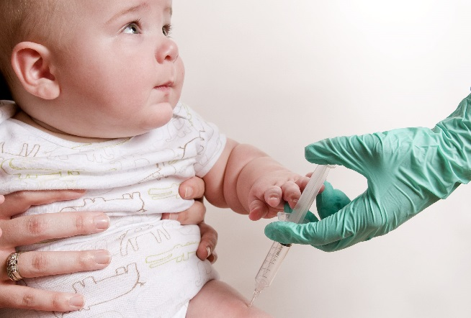
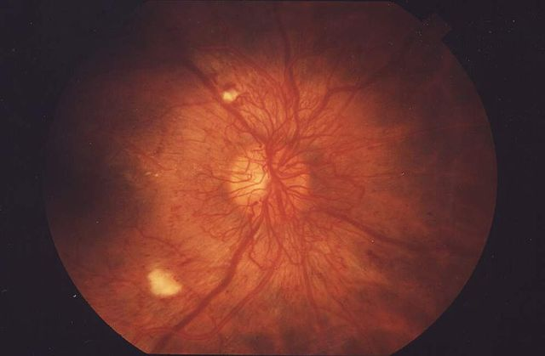
Different Populations need Different Management

Slide 10
Population Management Proactively Addresses Patient Needs
Healthy children and adults
People with chronic disease
People with special needs or at high risk for health problems
Notes:
Population management is about taking a Proactive approach - different populations of patients on your panel will have different health needs
--healthy kids/adults : Needs include screenings, immunizations, anticipatory guidance for preventive health
--chronic disease (DM, CHF, CAD, HTN, COPD/asthma): needs include disease-specific treatments and regular lab monitoring/screenings that are shown to improve patient-oriented outcomes
--”special needs” or “high risk”: frequent admissions, demented elderly, homeless, mental health issues, addiction, poor health literacy, language barriers, etc. Needs can include case management, interpretor services, social support, home visits, etc to help these patients self-manage as best as they are able

Slide 11
How to set up Population Management: Your Toolbox

Slide 12
Population Management Toolbox
DEFINE WHO:
Panel of patients assigned to one PCP or team
Common conditions and/or populations in your practice
NEED WHAT:
Patient registries for each population chosen
Clinical care markers/goals for each sub-population
Data recording on markers/goals
HOW TO ACT:
Empowered team members (Standing orders, defined workflows)
In reach and Out reach
Protected time for those doing the work

Slide 13
the WHO: choosing your sub-population
Population/Condition is common to your practice
Has significant morbidity/mortality or public health burden
Care as it exists may be variable
Evidence-based guidelines are available to inform interventions and outcomes:
Interventions: feasible, evidence-based, and likely to produce improved outcomes
Outcomes: measurable, reliable, and relevant (patient-oriented if possible)
Notes:
How do you identify people that need population management? Via the following characteristics:
Identify a population or condition that is common to your practice
The condition/conditions you are tracking have significant morbidity/mortality or public health burden
How your practice is giving care for this now is variable or not defined (not measured)
You have evidence of what you should be doing for this population, and have the ability to do so and to measure what you do
Note on outcomes: we often use HEDIS clinical quality markers as a measure of our outcomes (proxy measures) – not necessarily patient oriented, but they are easily measurable and reliable
What conditions do we currently or can we apply population management to? Record on a whiteboard examples of condition, disease/public health burden, intervention(s) and evidence for it, outcome measure(s)
Examples:
DM, hypertension, ASCVD or at-risk ASCVD
CHF with reduced systolic function
Osteoporosis (Fracture prevention)
Age-appropriate cancer screenings
Age-appropriate vaccines
Age-appropriate STD screening (chlamydia)
People on high-risk medications (warfarin, opiates)
Smokers
Depression (monitoring of PHQ-9 after SSRI start – measure is 50% reduction of PHQ-9 score after certain length of time on SSRI)

Slide 14
the WHAT: Setting up a Registry
Define parameters of your sub-population
Age
Gender
Condition or Clinical characteristics
Outcome measures being tracked
Identify patients in population based on your parameters
EMR filter search for diagnoses, labs, meds, etc
Paper / electronic chart review (with staff)
Patient surveys (self-identification)
Patients added manually over time
Notes:
Once you have chosen your condition, need a way to identify and track all the patients in that population. This is done with a registry
A registry is list of patients in a particular population, allow with the outcomes or measures that are being tracked that influence their health or affect quality of care.
Clinical characteristics can be the presence or absence of a diagnosis, medication, or symptom
You can add patients to registry quickly by doing EMR filter, or more slowly by doing chart review by hand or adding patients as they arrive or self-identify
Even if can’t capture entire population in the initial registry, getting a significant number through chart review/survey/etc makes population management worth your time
PRACTICE out loud: define the parameters of:
Population needing screening for AAA
Population needing to be on a high-dose statin according to new statin guidelines
Population recommended for HPV vaccine
Population that needs yearly creatinine and potassium for medication monitoring
.( Write up on whiteboard or flip chart )

Slide 15
Setting up a Registry (in EXCEL)
Image source: https://www.stepsforward.org/modules/point-of-care-registry
Additional Resource: “Using a Simple Patient Registry to Improve your Chronic Disease Care (Family Practice Management, April 2006). http://www.aafp.org/fpm/2006/0400/p47.html
Notes:
Many EMRs have built-in capacity to do this (PHASE tool that works with health connect is best example at Kaiser)
If no EMR, can do this in excel – cells can be formatted to turn a different color if the data value in the cell is outside a certain parameter (for example, been > 3 months since patient came for appointment, or A1C is > 8.0%). Downside is that someone has to enter in data by hand. Small practices that cannot afford EMR can assign staff members to do this.
This is an example of an excel spreadsheet with macro capability from an AMA resource on population management. Another example with a downloadable tool is available through AAFP website (link included on slide)

Slide 16
the WHAT: Choose your Outcomes
Use evidence-based guidelines from your population or condition to identify clinical measures and screens (AHQR, USPSTF, AAFP)
Patient-oriented outcomes if possible and reasonable; use good proxies if not
Data should be minimally cumbersome to collect and document
Notes:
Patient oriented outcomes are best, but may be more cumbersome/take too long to track. We track A1c with a specific goal, but what we are really wanting to track is reduction of diabetic complications that are linked to A1C
Decide what you would want your patient-oriented outcome to be, but if it is too cumbersome to track that, work backwards to interventions that are reliably thought to affect this outcome and are easier to measure.
EXAMPLE: we used to measure LDL numbers of people on statins. Why? It was a proxy measure of how well we were reducing their risk of ASCVD outcomes (theoretically)
Now we track whether people who have or are at high risk of ASCVD are on statins at all, without looking at the LDL numbers. Newer studies showed that having these people on a statin at a particular dose is a better way to reduce MI and stroke than trying to achieve a particular LDL number.
Think of a few populations that we track now. Refer back to list that we made together as a group when identifying population parameters. What are our outcome measures for these conditions?
Are they patient-oriented or not? If not, what is the patient-oriented outcome that we are actually trying to achieve?
Many health organizations will use HEDIS quality measures as their outcome measures for specific patient populations

Slide 17
Clinical Quality Markers – a word on HEDIS
Notes:
Who knows what HEDIS measures are? Why do we care about thaem?

Slide 18
Help, my Education Didn’t Include this Stuff… (HEDIS)
NCQA (non-profit, independent)
Health Plans and Medicare/Medicaid
Notes:
HEDIS stands for Healthcare Effectiveness Data and Information Set. The National Committee for Quality Assurance (NCQA) determines what data will be included in HEDIS reports. 90% of health plans in America measure and report this data set.
Standardized measures in HEDIS are meant to help consumers and employers compare health plans “apples to apples” – to compare how different health plans improve the health of different populations of patients. They are not originally designed for quality improvement, although many organizations use them for this.
CMS also uses some HEDIS measures to determine their “star ratings” of health plans. A health plan that gets the highest rating can qualify for incentive payments, and also has opportunity to enroll medi-care members year-round instead of just during open enrollment
This data is also available to the public and health plans that perform well will look more attractive
When deciding on measures (whether to add new ones or keep old ones), NCQA committee considers attributes like:
--relevance (is information important to patients/providers/health plans, will it inform health care choices or stimulate quality improvement)
--scientific soundness (what is the evidence for this clinical marker)
--feasibility (is this data reasonable to collect)
Measures are added and/or reviewed every several years.

Slide 19
The HOW: Contact the patients
In-Reach: Ensuring scheduled patients are offered preventive and routine services when they come in for any reason.
Out-reach: Contacting patients on your panel who do not have scheduled visits to offer them preventive and routine services.
Notes:
How can we do the work of population management?
Make sure you are contacting patients proactively – use in-reach and out-reach
Help your other clinical team members do both in-reach and out-reach to patients as part of their work – all team members that touch patients during their care should be able to do this
Empower your staff to help you with standing orders and workflows
This can empower staff to help you with in-reach (taking care of all patient needs at every touch) and out-reach, in your absence or without your approval every time
Considerations for standing orders and workflows:
Who will actually deliver care, when, and where?
Who will record clinical measures and outcomes?
Where will documentation live, who will update it?
Who are the stakeholders that should be involved in deciding the workflow, and who needs to agree to it or approve it?
What licensure is needed for the people doing the work?
Examples of standing workflows that exist for population management currently? (For example: cancer screenings that can be ordered w/o physician approval)

Slide 20
the HOW: Standing orders and Workflows
Standing orders: allow other staff members to take approved action that affects patient care
MA identifies patients due for CRC screening and offers home FIT kit. FIT kit is returned and lab order is entered under PCP name
MA or receptionist identifies patients needing preventive services ( mammogram, bone density, pap) and books them appointment
Workflows: actions, steps, or tasks to achieve a certain result
Standing orders often need defined workflows
Workflow Mapping – visual representation of steps
Team members who will be carrying out workflow should help make it / provide feedback about it
Notes:
How can your team members help you with population management? Two tools include standing orders and workflows
Standing orders:
--often based on national guidelines, but can also be created internally in an organization
--must be approved by clinical leadership
--staff must be trained and must be comfortable acting on standing orders
Workflows can help standing orders be carried out more smoothly
A visual map of workflow can aid in training, reminder of steps, and can help identify potential bottlenecks or problems

Slide 21
Case: Lee Has a Panel Manager
Notes:
CASE STUDY:
--One day, Lee receives a call from his clinic.
--Jennifer, his team’s panel manager, has pulled a list of patients who are due for colon cancer screening from their EMR. She calls him to find out what kind of screening he would prefer.
--After a brief conversation, he agrees to FIT testing, and is scheduled for a Medical Assistant visit to receive a kit.
--At the FIT-kit visit, the MA offers Lee an appointment with his assigned PCP.
--Impressed by the clinic’s commitment to preventing illness, Lee decides to meet with a primary care provider and see what else he can do to improve his health.

Slide 22
Notes:
Time to practice! Proceed to the “Choose your own Population” activity

Slide 23
Evaluation
Notes:
Evaluation of didactic and activity following conclusion of Choose your own Population exercise

